Slide 1
Learning To Rank
(2021, AlgoExpert)
Yang Xi’s Reading Note

Slide 2
Table of Content
Basic Ideas
Basic Formulation
Learning To Rank – an example
RankNet
LambdaNet and NDCGLambdaNet and LambdaMART
Multiple Additive Regression Trees (MART)
Evaluation Metrics
Example – Personalized Feed and De-bias Clicks
Example – Application Performance

Slide 3
Basic Ideas
Retrieve the top-K from a candidate generator
A system which outputs the candidates to be ranked
For extracting the top-K, we can generate a more sophisticated model, because we are only dealing with a small fraction of the users and the items (posts)
If we have different systems generating candidates, we can subset users into groups. Say one group of users from Amazon, another group from Google, and these exist in separate embedding spaces.
In this case, we need to have some mechanism to rank across different embeddings.
Rank the top candidates
Say, the candidate generator suggests A-C-B.
The “ideal” ranking is A-B-C.
Say we get is from user clicks. Say the user clicked on A then B but not C, so A-B-C sounds ideal.
The goal is to tell why A-B-C is better than A-C-B.
From A-C-B to A-B-C, we need one inversion.
Train a model
Output some ranking
penalized by how many inversions it took to restore the ideal ordering

Slide 4

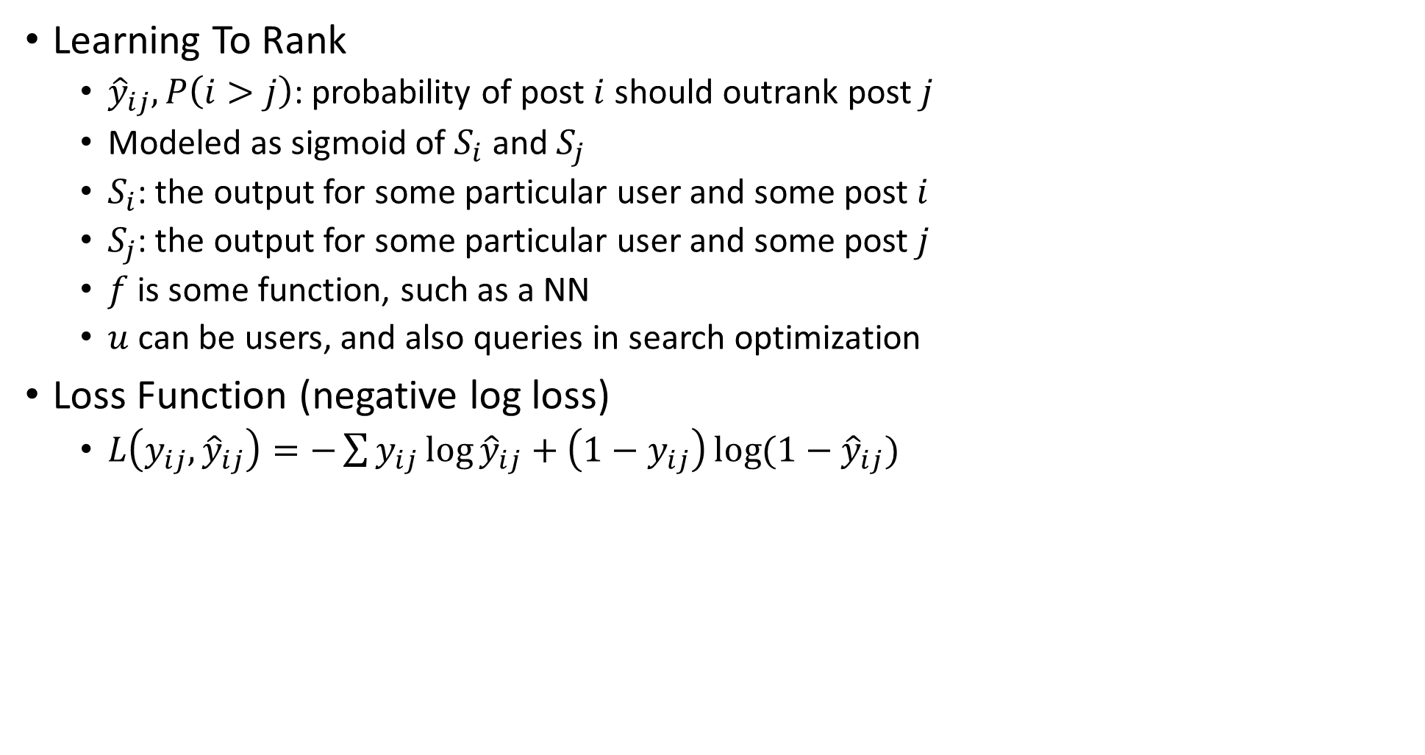
Basic Formulation
$${\hat{y}}_{ij}=P\left(i>j\right)=\frac{1}{1+e^{−(S_{i}−S_{j})}}$$
$$S_{i}=f\left(u, d_{i}\right)$$
$$S_{j}=f(u,d_{j})$$
Learning To Rank
${\hat{y}}_{ij},P\left(i>j\right)$: probability of post $i$ should outrank post $j$
Modeled as sigmoid of $S_{i}$ and $S_{j}$
$S_{i}$: the output for some particular user and some post $i$
$S_{j}$: the output for some particular user and some post $j$
$f$ is some function, such as a NN
$u$ can be users, and also queries in search optimization
Loss Function (negative log loss)
$L\left(y_{ij},{\hat{y}}_{ij}\right)=−\sum{y_{ij}\log{{\hat{y}}_{ij}}+\left(1−y_{ij}\right)\log{(1−{\hat{y}}_{ij})}}$

Slide 5
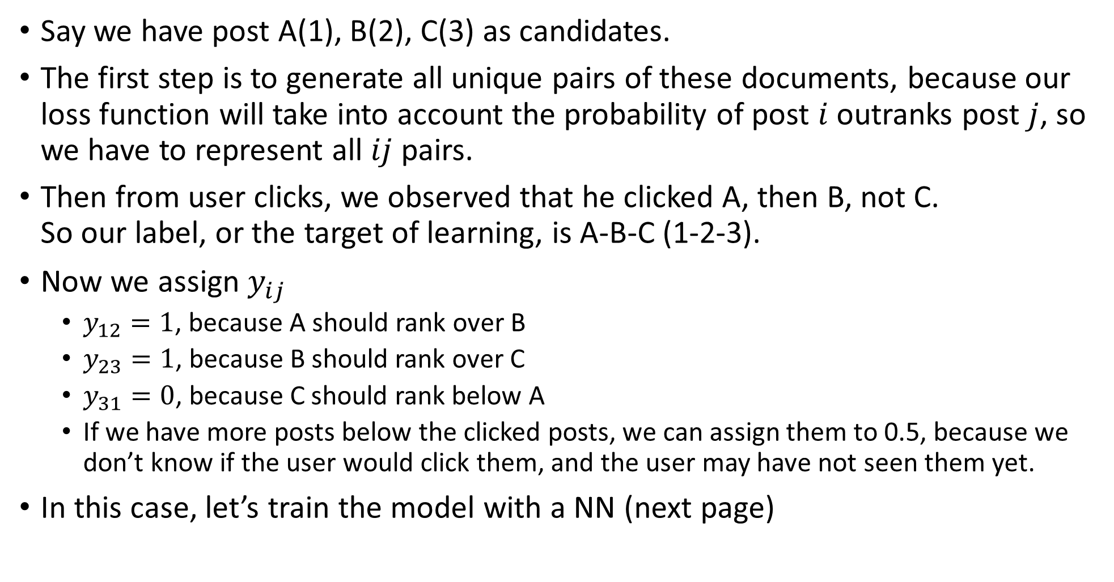
Learning To Rank – an example
Say we have post A(1), B(2), C(3) as candidates.
The first step is to generate all unique pairs of these documents, because our loss function will take into account the probability of post $i$ outranks post $j$, so we have to represent all $ij$ pairs.
Then from user clicks, we observed that he clicked A, then B, not C. So our label, or the target of learning, is A-B-C (1-2-3).
Now we assign $y_{ij}$
$y_{12}=1$, because A should rank over B
$y_{23}=1$, because B should rank over C
$y_{31}=0$, because C should rank below A
If we have more posts below the clicked posts, we can assign them to 0.5, because we don’t know if the user would click them, and the user may have not seen them yet.
In this case, let’s train the model with a NN (next page)

Slide 6

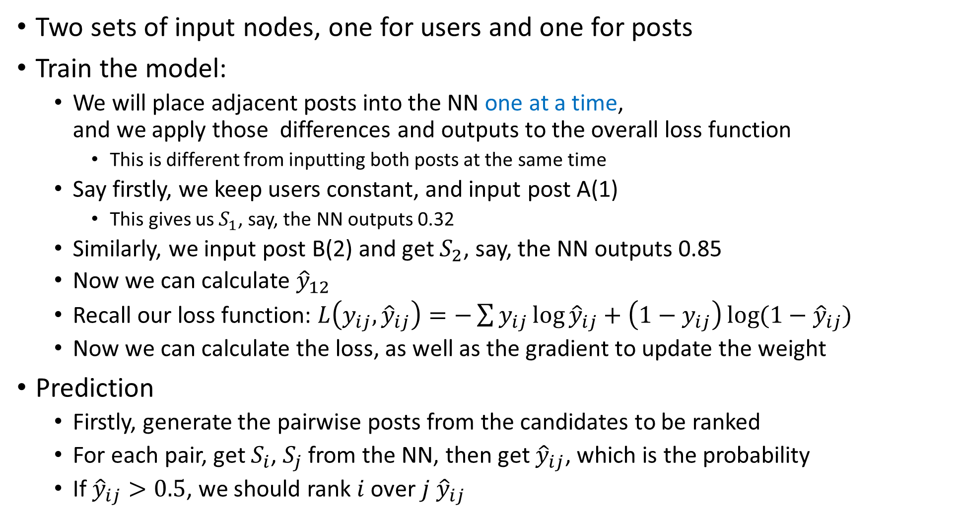

RankNet
$${\hat{y}}_{ij}=P\left(i>j\right)=\frac{1}{1+e^{−(S_{i}−S_{j})}}$$
$$S_{i}=f\left(u, d_{i}\right)$$
$$S_{j}=f(u,d_{j})$$
Two sets of input nodes, one for users and one for posts
Train the model:
We will place adjacent posts into the NN one at a time, and we apply those differences and outputs to the overall loss function
This is different from inputting both posts at the same time
Say firstly, we keep users constant, and input post A(1)
This gives us $S_{1}$, say, the NN outputs 0.32
Similarly, we input post B(2) and get $S_{2}$, say, the NN outputs 0.85
Now we can calculate ${\hat{y}}_{12}$
Recall our loss function: $L\left(y_{ij},{\hat{y}}_{ij}\right)=−\sum{y_{ij}\log{{\hat{y}}_{ij}}+\left(1−y_{ij}\right)\log{(1−{\hat{y}}_{ij})}}$
Now we can calculate the loss, as well as the gradient to update the weight
Prediction
Firstly, generate the pairwise posts from the candidates to be ranked
For each pair, get $S_{i}$, $S_{j}$ from the NN, then get ${\hat{y}}_{ij}$, which is the probability
If ${\hat{y}}_{ij}>0.5$, we should rank $i$ over $j$ ${\hat{y}}_{ij}$
$$y_{12}=1$$
$$y_{23}=1$$
$$y_{31}=0$$

Slide 7
LambdaNet and NDCG
RankNet – Limitations
The pairwise may not be the best penalty.
We may want to consider more than just two posts at a time
Inefficient: Large amount of pairs for large amount of posts
Solution: LambdaNet
More efficient: factorize the gradient to find the gradient update for a post in comparison to all the others, without having to evaluate itself versus every other.
Enable usage of better metrics
Normalized Discount Cumulative Gain (NDCG): considers more than a pair of posts
Considers post up to position k
Refer to (2020 Queirozf) Evaluation Metrics for Ranking Problems for more info.
Challenge: NDCG is not differentiable
Solution: See next page

Slide 8
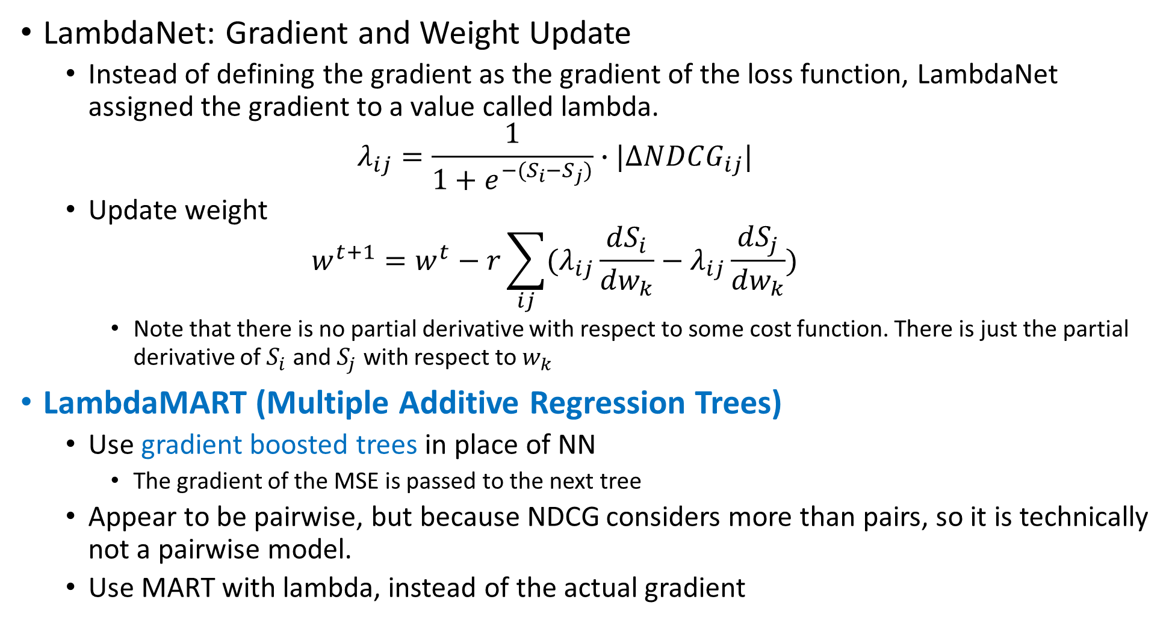
LambdaNet and LambdaMART
LambdaNet: Gradient and Weight Update
Instead of defining the gradient as the gradient of the loss function, LambdaNet assigned the gradient to a value called lambda. $λ_{ij}=\frac{1}{1+e^{−(S_{i}−S_{j})}}∙|∆NDCG_{ij}|$
Update weight $w^{t+1}=w^{t}−r\sum_{ij}{(λ_{ij}\frac{dS_{i}}{dw_{k}}−λ_{ij}\frac{dS_{j}}{dw_{k}})}$
Note that there is no partial derivative with respect to some cost function. There is just the partial derivative of $S_{i}$ and $S_{j}$ with respect to $w_{k}$
LambdaMART (Multiple Additive Regression Trees)
Use gradient boosted trees in place of NN
The gradient of the MSE is passed to the next tree
Appear to be pairwise, but because NDCG considers more than pairs, so it is technically not a pairwise model.
Use MART with lambda, instead of the actual gradient

Slide 9
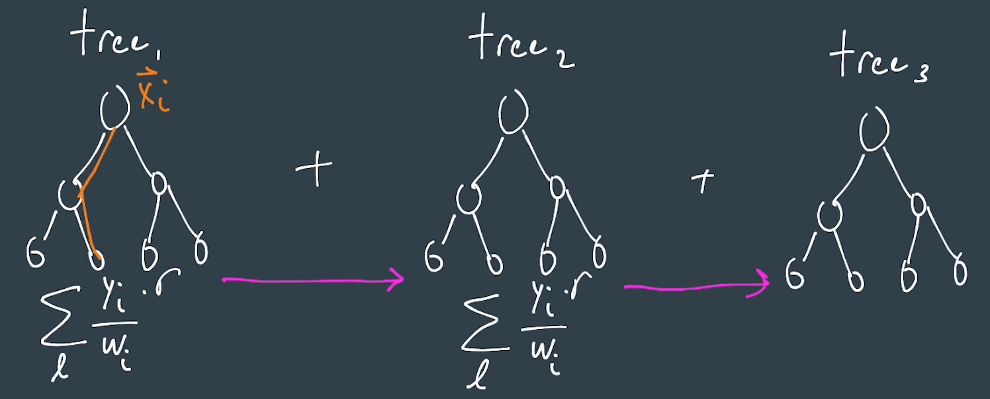
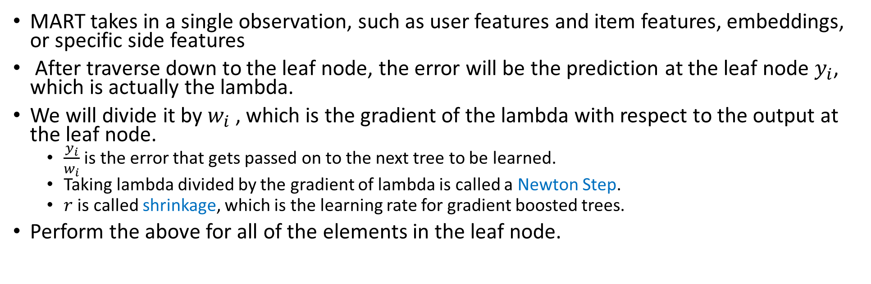
Multiple Additive Regression Trees (MART)
MART takes in a single observation, such as user features and item features, embeddings, or specific side features
After traverse down to the leaf node, the error will be the prediction at the leaf node $y_{i}$, which is actually the lambda.
We will divide it by $w_{i}$, which is the gradient of the lambda with respect to the output at the leaf node.
$\frac{y_{i}}{w_{i}}$ is the error that gets passed on to the next tree to be learned.
Taking lambda divided by the gradient of lambda is called a Newton Step.
$r$ is called shrinkage, which is the learning rate for gradient boosted trees.
Perform the above for all of the elements in the leaf node.

Slide 10
Evaluation Metrics
NDCG: Average NDCG across all users
MAP: Mean Average Precision (for binary relevance)
MRR: Mean Reciprocal Rank (binary)
Sometimes, it is preferable to encode n-array labels as binary for evaluation.
All of these can be used in the lambda - can replace NDCG with MAP or MRR.

Slide 11
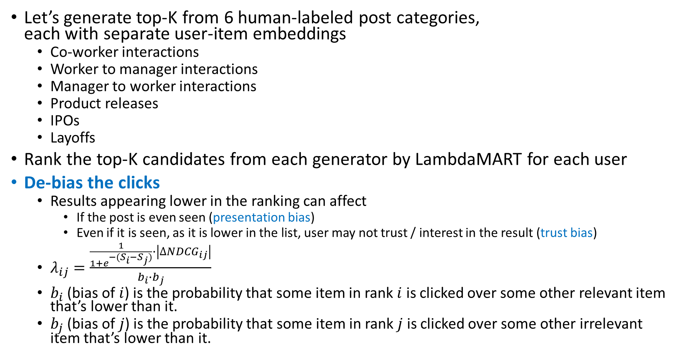
Example – Personalized Feed and De-bias Clicks
Let’s generate top-K from 6 human-labeled post categories, each with separate user-item embeddings
Co-worker interactions
Worker to manager interactions
Manager to worker interactions
Product releases
IPOs
Layoffs
Rank the top-K candidates from each generator by LambdaMART for each user
De-bias the clicks
Results appearing lower in the ranking can affect
If the post is even seen (presentation bias)
Even if it is seen, as it is lower in the list, user may not trust / interest in the result (trust bias)
$λ_{ij}=\frac{\frac{1}{1+e^{−(S_{i}−S_{j})}}∙\left|∆NDCG_{ij}\right|}{b_{i}∙b_{j}}$
$b_{i}$ (bias of $i$) is the probability that some item in rank $i$ is clicked over some other relevant item that’s lower than it.
$b_{j}$ (bias of $j$) is the probability that some item in rank $j$ is clicked over some other irrelevant item that’s lower than it.

Slide 12
Example – Application Performance
Our personalized feed
Increased app session time by over 25%
Decreased feed scrolling time by 10%
Users tend to find the relevant items fast without much scrolling around

